Slide 1

a ssetopus

Slide 2
©
Asset Buddy
efficient asset monitoring

Slide 3
©
Asset Buddy
efficient asset monitoring

Slide 4
©
Asset Buddy
efficient asset monitoring

Slide 5
©
Asset Buddy
efficient asset monitoring

Slide 6
©
Asset Buddy
efficient asset monitoring

Slide 7
©
Asset Buddy
efficient asset monitoring

Slide 8
a ssetopus
Report something new
set a task
do a commercial task
Do a task the asset manager sets
do a community task

Slide 9
a ssetopus
set a task
do a commercial task
do a community task

Slide 10
a ssetopus
sign in using facebook
sign in using twitter
sign in using email

Slide 11
a welcome back Elly!
Phone notifications of tasks whilst you are on the go
Task Near Me
Task Notifications
Quick task function
Task Explorer
Extreme inspections!
Task Challenger
Makes a walk/active trip
See number and the impact of your tasks
Get rewarded!
Task
Together
Task
Rewards
Meet new people
Social media

Slide 12
a welcome back Elly!
Task Near Me
Task Notifications
Task Explorer
Task Challenger
Task
Together
Task
Rewards

Slide 13
a Task near me
Max distance km
Max time min
Level
Easy Active Elite

Slide 14
a Task near me
Max distance 2 km
Max time 30 min
Level
Easy Active Elite

Slide 15
a Task near me
Max distance 2 km
Max time 30 min
Level
Easy Active Elite

Slide 16
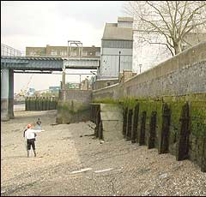
a Task near me
Tides out!
Go look at a river wall!
DO TASK

Slide 17
a Task near me
Tides out!
Go look at a river wall!
Health and Safety moment:
Wear sensible shoes
Never put yourself at risk
DO TASK

Slide 18
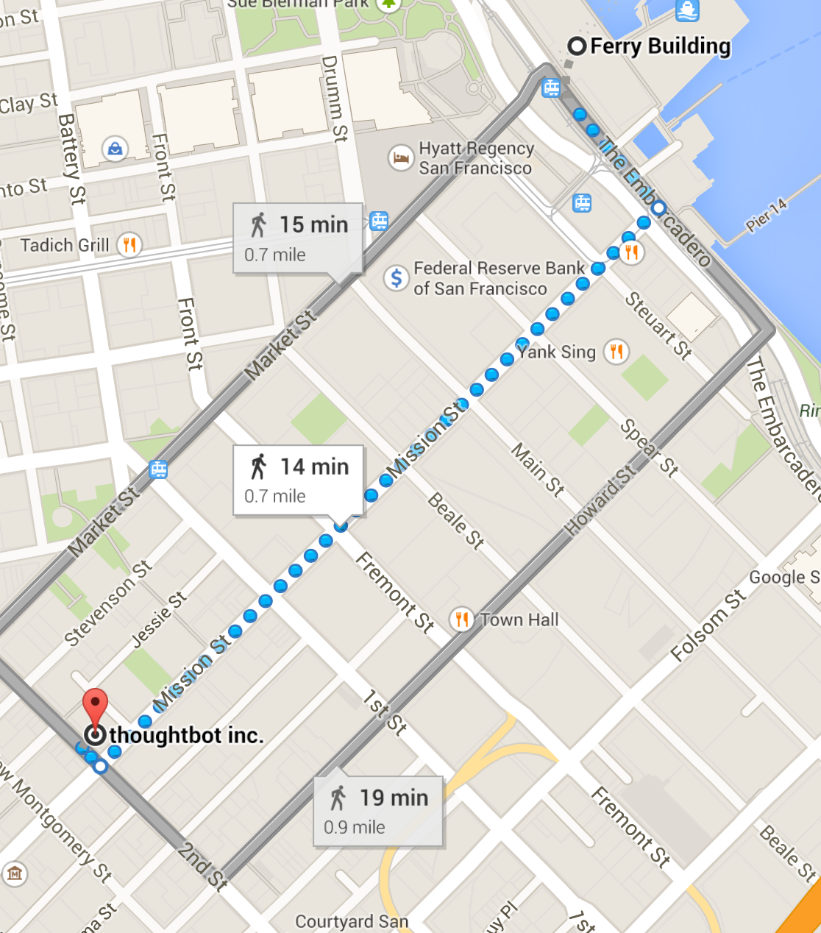
a Task near me – let’s go!
ASSET
Report health and safety issue
YOU
Ready to take the photo?

Slide 19
a
AUGMENTED REALITY

Slide 20
a
Is this your best photo?

Slide 21
a welcome back Elly!
Task Near Me
Task Notifications
Task Explorer
Task Challenger
Task
Together
Task
Rewards

Slide 22
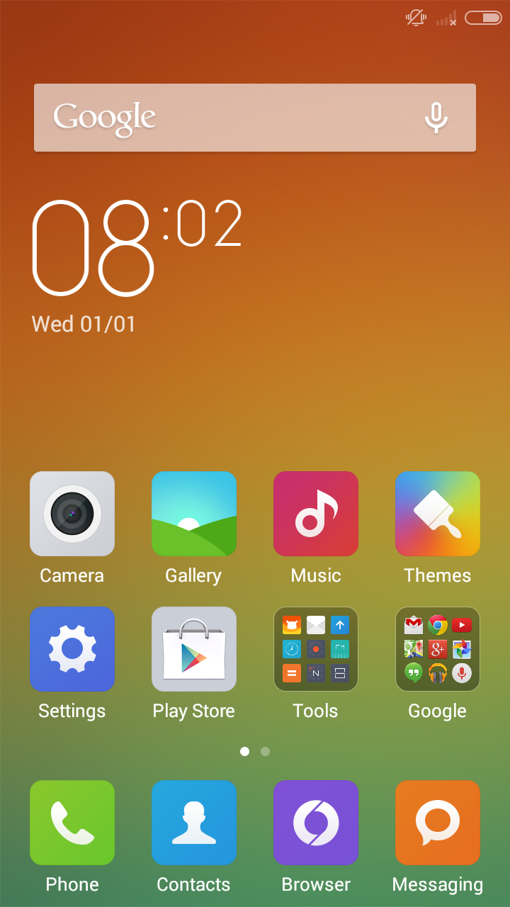
Hey we have a task for you
User preferences for preferred task distance, level and time.

